Slide 1


VACUUM 101
Lesson 2
Vacuum Basics

Slide 2

Lesson 2
Vacuum Basics
Objectives
  How do we describe a gas?
    Volume, Temperature, Pressure
  What defines a vacuum?
  How can we measure vacuum?
Photo by JD Hancock: http://photos.jdhancock.com/photo/2013-06-04-212438-the-lonely-vacuum-of-space.html

Slide 3
Lesson 2
Vacuum Basics
Kinetic Theory
3 basic assumptions
Gases are composed of extremely small particles called molecules.
Gas molecules move continuously.
Kinetic Energy (stored up energy) depends on temperature.
Photo by JD Hancock: http://photos.jdhancock.com/photo/2013-06-04-212438-the-lonely-vacuum-of-space.html

Slide 4
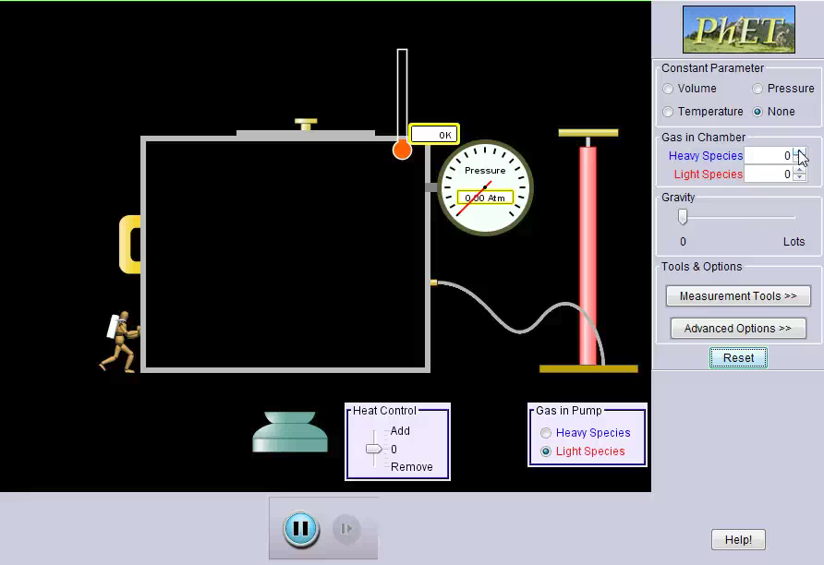
Lesson 2
Vacuum Basics
Photo by JD Hancock: http://photos.jdhancock.com/photo/2013-06-04-212438-the-lonely-vacuum-of-space.html

Slide 5
Lesson 2
Vacuum Basics
What you need to know to describe a gas
  Volume (space occupied)
  Temperature (hot or cold)
  Pressure (force per unit area)
Photo by JD Hancock: http://photos.jdhancock.com/photo/2013-06-04-212438-the-lonely-vacuum-of-space.html

Slide 6
Lesson 2
Vacuum Basics
Volume: The volume (V) of the container equals the volume of the gas
  Labeled V
  Measured in ft³ (cubic feet) or m³ (cubic meters)
Temperature: The temperature (T) is measured using a gauge or sensor
  Labeled T
  Temperature affects the average speed of the molecules
  Higher temperature= faster molecules
Photo by JD Hancock: http://photos.jdhancock.com/photo/2013-06-04-212438-the-lonely-vacuum-of-space.html

Slide 7
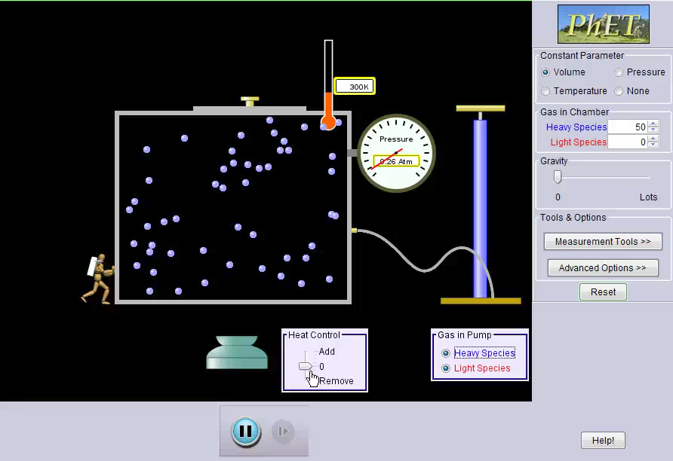
Lesson 2
Vacuum Basics
Photo by JD Hancock: http://photos.jdhancock.com/photo/2013-06-04-212438-the-lonely-vacuum-of-space.html

Slide 8
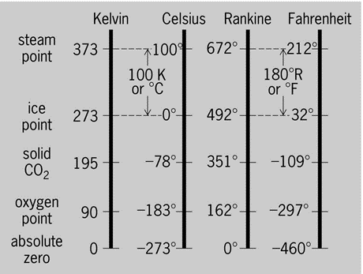
Lesson 2
Vacuum Basics
Measuring Temperature
There are different units for measuring temperature
  Fahrenheit (ºF)
  Celsius (or Centigrade) (ºC)
  Kelvin (°K)
  Rankine (°R)
Photo by JD Hancock: http://photos.jdhancock.com/photo/2013-06-04-212438-the-lonely-vacuum-of-space.html

Slide 9
Lesson 2
Vacuum Basics
Measuring Pressure
Pressure (P) measures the amount of Force (F) over Area (A)
P = F/A
    Sometimes referred to as Pounds per Square Inch (PSI)
    But that is only the beginning….
Photo by JD Hancock: http://photos.jdhancock.com/photo/2013-06-04-212438-the-lonely-vacuum-of-space.html

Slide 10
Lesson 2
Vacuum Basics
Atmospheric Pressure
Atmospheric pressure is measured with a barometer
  Air pushes down on a Mercury (Hg) pool
  Pushing the mercury (Hg) up a glass tube
  This mercury rises to 29.92” at sea level
  29.92 in Hg abs can also be referred to the following:
  1 atmosphere (1 atm)
  760.0 mm Hg abs
  101.3 kPa
  1013 mbar
  14.7 psia
Photo by JD Hancock: http://photos.jdhancock.com/photo/2013-06-04-212438-the-lonely-vacuum-of-space.html

Slide 11
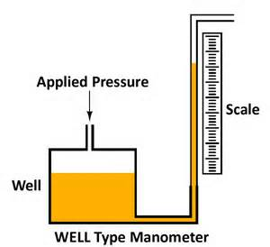
Lesson 2
Vacuum Basics
Measuring Pressure
Basic Conversion Factors as related to “Torr” :
Torr – basic metric measure of pressure used most frequently
0.0010 Torr | 1 micron
0.0076 Torr | 1 pascal (Pa)
.75 Torr | 1 millibar (mbar)
1.00 Torr | 1 mm Hg
25.40 Torr | 1 in. Hg
51.71 Torr | 1 psi
760 Torr | 1 atm
Photo by JD Hancock: http://photos.jdhancock.com/photo/2013-06-04-212438-the-lonely-vacuum-of-space.html

Slide 12
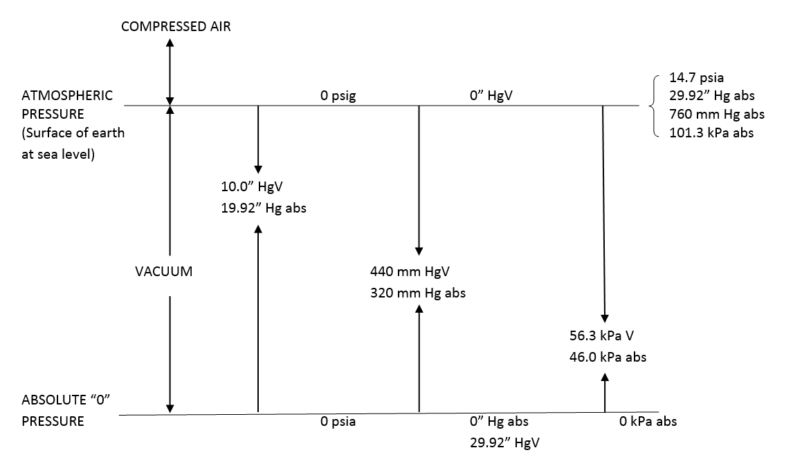
Lesson 2
Vacuum Basics
Different Ways to Measure Pressure
World of Vacuum Measurement Chart
Photo by JD Hancock: http://photos.jdhancock.com/photo/2013-06-04-212438-the-lonely-vacuum-of-space.html

Slide 13
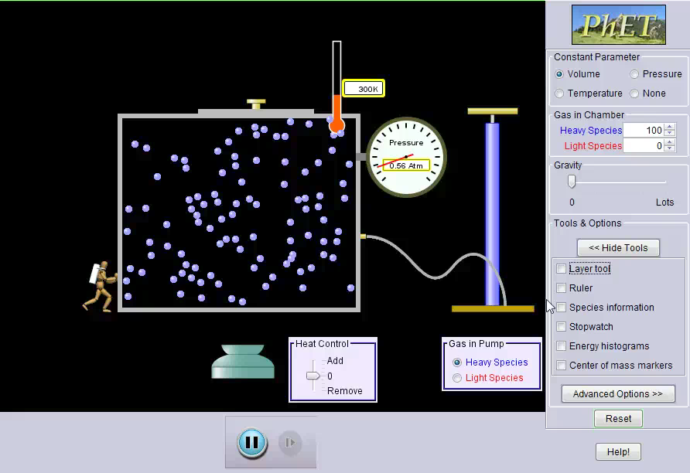
Lesson 2
Vacuum Basics
Photo by JD Hancock: http://photos.jdhancock.com/photo/2013-06-04-212438-the-lonely-vacuum-of-space.html

Slide 14
Lesson 2
Vacuum Basics
Atmospheric Pressure
As we saw earlier, in the presence of gravity the pressure must decrease as you go higher in altitude.
The effect is significant:
  Average P at sea level = 29.92 in Hg abs
  Average P at 5,000 ft = 24.92 in Hg abs (Denver)
  Average P at 30,000 ft = 8.9 in Hg abs (Mt. Everest)
Photo by JD Hancock: http://photos.jdhancock.com/photo/2013-06-04-212438-the-lonely-vacuum-of-space.html

Slide 15
Lesson 2
Vacuum Basics
Summary
A gas consists of molecules moving and colliding like tiny tennis balls.
We describe a gas by its:
  Volume
  Temperature
  Pressure
Living at the bottom of the atmosphere, there is a higher pressure
Extremely important for measuring vacuum
Remember: pressure decreases as altitude increases
Photo by JD Hancock: http://photos.jdhancock.com/photo/2013-06-04-212438-the-lonely-vacuum-of-space.html

Slide 16
Lesson 2
Vacuum Basics
You have completed Lesson 2!
Vacuum University brought to you by Dekker Vacuum Technologies, Inc.
Copyright © 2015 by Vacuum University, Inc.
THIS WEBSITE AND MATERIALS CONTAINED WITHIN ARE CONFIDENTIAL AND PROPRIETARY TO VACUUM UNIVERSITY, LLC. AND MAY NOT BE REPRODUCED, PUBLISHED, OR DISCLOSED TO OTHERS WITHOUT COMPANY AUTHORIZATION
No part of this work may be reproduced in whole or in part in any manner without the permission of the copyright owner.
No part of the materials available through the VACUUMUNIVERSITY.NET site may be copied, photocopied, reproduced, translated, or reduced to any electronic medium or machine-readable form, in whole or in part, without prior written consent of VACUUM UNIVERSITY, LLC is prohibited.
All materials contained on this site are protected by United States copyright law and may not be reproduced, distributed, transmitted, displayed, published, or broadcast with the prior written permission of VACUUM UNIVERSITY, LLC.
Photo by JD Hancock: http://photos.jdhancock.com/photo/2013-06-04-212438-the-lonely-vacuum-of-space.html

